Slide 1
Braingile - Unlock Developer's Feature level confidence - <Feature Name>
One initiative to improve developer velocity
Background for Braingile (Brain + Agile)
While working on feature, tech/dev team must take consideration of bunch of things like for example ecosystem consultations, interface consideration, API, API enablement, documentation, architecture, translations, virtualization, figma links, UI related changes and many mores. Observations was many times team used to miss out things and at the time of sprint execution, we witnessed many impediments and that delayed the delivery.
Clicked an idea to address this problem, where i produced checklist gamification like at the start of project, all team sits together and perform brainstorming together and identify all the possible connecting dots. And at each stage of the development, team members who identifies things earlier, will get credits. At the end, we will decide champion team and champion team members.
Expecting following benefits -
More we identify things earlier, likely to experience less impediments at the time of sprint execution.
As we get time and chance to resolve the issues way earlier, delivery would be indirectly smoother.
Gamification gives extra advantage to keep team engaged and add fun.
Expecting improvement in developer velocity by 30 to 40 percent or even more.
It will encourage people to participate and talk the feature level things at each stage of Agile project life cycle.
6. It's kind of creating competitive environment without compromising with the spirit of the team and improve the project
efficiency overall.
Link to Braingile → https://eviden-my.sharepoint.com/:x:/p/abhijeet_mukkawar/Ee3kvt9BbrpJvPXqJjiE34ABMNMiNI2lI-LVvf4u8lyBJw?e=1jIFeI

Slide 2
Continuous Improvement – Defect Control - Defect Prevention
One initiative to improve overall end customer experience
Background
It’s quite possible to have development defects due speediness of deliverables and continuous changes are inevitable
Changed perception towards bug findings and bug fixing. It’s okay to fix n number of defects until changes haven’t gone live.
Development team and Testing team are no more like a cat and mouse game if they work collaboratively and work with right positive mindset, we can find unbelievable results.
It’s a power of collaboration and togetherness. Building synergy in teams and working with right mindset when it comes to defect and solution fixing
Defect Prevention Activity (DPA) is a continuous team activity where teams can discuss dev defects, analyse the patterns, understand what went wrong while coding, Understand the learnings, share with other team members, make a logical conclusion, make necessary adjustment in each phase of SDLC, and aim for preventive measures when it comes to defects.
How to do that → Learning from failures and get ready before next testing cycle
Extract defect lists from past release with all details like title, ID, Business Priority, resolution details (Developer comments)
Arrange for brainstorming sessions with team
Prepare target plans
Bring testing team to sessions for feedback
We need to make sure; each stage of development is robust enough to catch the observations earlier than in regression testing like try to check closely during your story prebuild, code reviewer can have more robust checking, try to check if we can capture something during test executions and so on

Slide 3
Long Pending blocked defects
One initiative - Managing defect tracking in different way

Slide 4
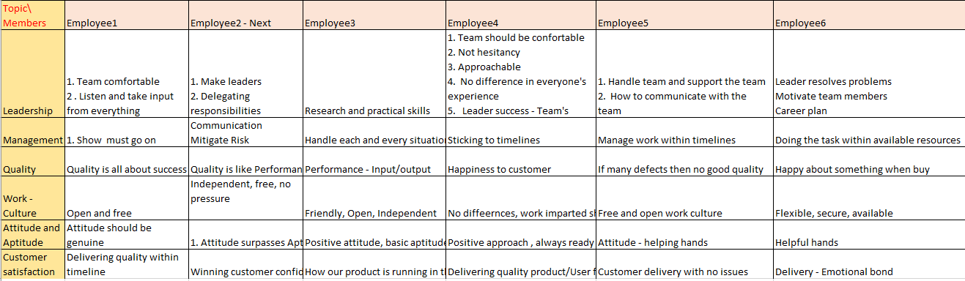
Scrum Ceremony - Sprint Retrospective
One initiative – to make retro more meaningful

Slide 5
Innovation
One initiative – streamline innovation
How we approach to Innovation
Phases of Innovation
Past data Insights
Benefits to Customer and Eviden
Link to Innovation presentation → https://eviden-my.sharepoint.com/:p:/p/abhijeet_mukkawar/EdT0EVzDO4BGthN6ACVoGyMBoL9B4ekDW_Sx7jiowCkSSQ?e=1jxi9O

Slide 6


Accelerating the Fresher’s Mentorship Program
Idea of having quiz is not to judge mentee like how they are, but to understand
where they are, so mentors can fill their knowledge gap accordingly and empower them
Mentee
Mentors
Focus Quiz #1
Basic Platform Technical
A] Our Mentors have carefully crafted a quiz (with 30-40 questions) on basic technical
iOS And Android - often, questions are from day-to-day dev tasks or story development.
B] We administered an hour-long test to assess their current knowledge.
C] Post test, a one-on-one mentoring session was organized to fill knowledge gaps..
A] We tried to focus on domain expertise here. We compiled a list of 30-40 questions that can
cover high-level and edge functionality.
B] We administered an hour-long test to assess their current knowledge.
C] Following the test, a one-on-one mentoring session was organized to fill knowledge gaps.
Focus Quiz #2
Domain
Focus Quiz #3
Process
A] We tried to focus on overall process (Change management, Agile and Tool).
We compiled a list of 30-40 questions that can cover end to end process understanding.
B] We administered an hour-long test to assess their current knowledge.
C] Following the test, a one-on-one mentoring session was organized to fill knowledge gaps.
A] We tried to focus on overall programming sense and day to day technical issues (Change
management and Tools). We compiled a list of 30-40 questions that can cover timebox
programming and basic troubleshooting.
B] We administered an hour-long test to assess their current knowledge.
C] Following the test, a one-on-one mentoring session was organized to fill knowledge gaps.
Focus Quiz #4
Programming & trouble-shooting

Slide 7
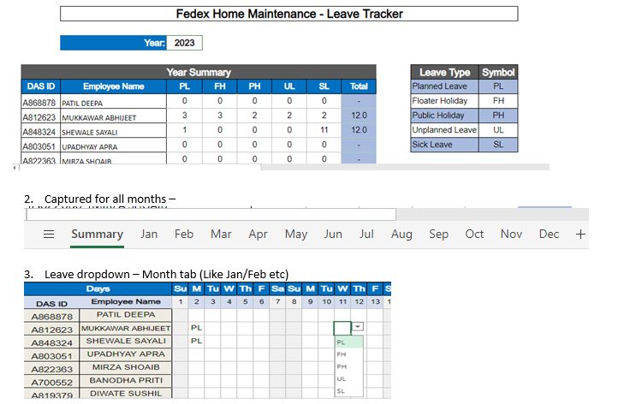
Team Level – Leave tracker
Managing Employee leaves tracking in different way

